Slide 1
Classification: Overview of Advanced Methods
P. Krishna Reddy, IIIT Hyderabad
1
Notes:
1

Slide 2
Detailed Syllabus
Introduction (1.5 hour): Definition, KDD framework, Issues in data mining.
Data summarization (7.5 hrs): Data Types, Preprocessing, Characterization, Discrimination, data warehousing techniques (Multidimensional data model, Data warehousing architecture, Data cube computation and OLAP technology)
Mining patterns and associations (9 hours) Introduction to Association mining, a priori algorithm, FP growth, ECLAT, Overview of other algorithms, Pattern Evaluation, Overview of advanced pattern mining
Classification and regression (9hrs) (Overview, Decision tree induction, Over-fitting and under-fitting, Scalable decision tree algorithms, Bayesian Classification, Overview of Advanced Methods
Concepts and algorithms for clustering the data (9 hours) (Overview, Types of Data, K-means, Aglomerative clustering, Clustering algorithms (DBSCAN, BIRCH, CURE, ROCK, CHAMELEON)).
Outlier analysis and future trends (graph mining, spatio-temporal mining). (3 hours)

Slide 3
Outline
Feature Selection and Engineering
Bayesian Belief Networks
Support Vector Machines
Rule based and pattern based classification
Classification by weak supervision
Classification with rich data type
Other Classification Methods
Additional Topics Regarding Classification
Summary
3
Notes:
3

Slide 4
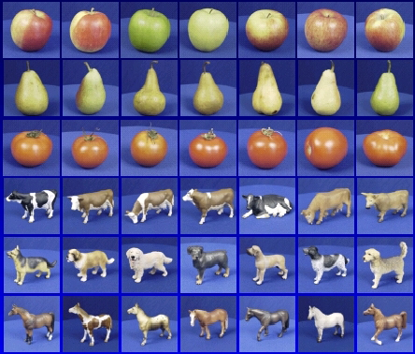

Steps
Training
Training Labels
Training Data
Features
Training
Learned model
Testing
Features
Learned model
Prediction
Test sample

Slide 5
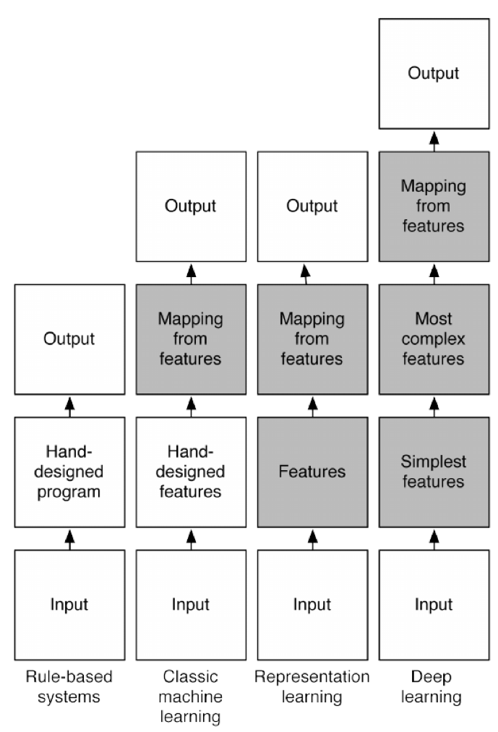
What is deep learning?
Y. Bengio et al, ``Deep Learning”, MIT Press, 2015

Slide 6
About feature selection and Engineering
So far, we assumed
A training set of with n tuples for p attributes (features) is available.
Question, where do these features have come?
Feature selection:
Large number of features are collected (thousands or more)
Question: how to select a subset of features from initial set of p features to improve generalization (classification) performance?
Example:
Student ID is irrelevant to predict whether a student will drop the course.
Monthly income and yearly income of redundant features to predict “Buy Computer”
Irrelevant attributes make classifier sensitive to noise.
Feature Engineering: How can I construct p features so that all of them are critical for the classification task I have?
Given set of p features, can I transform them to p’ attributes so that these transformed features will be more effective for classification?
Example: Health surveillance data which includes number of daily positive cases, number of daily tests, number of daily hospitalization.
It has turned out that weekly positive rate is powerful indicator for disease outbreak.
It can be derived from the daily data

Slide 7
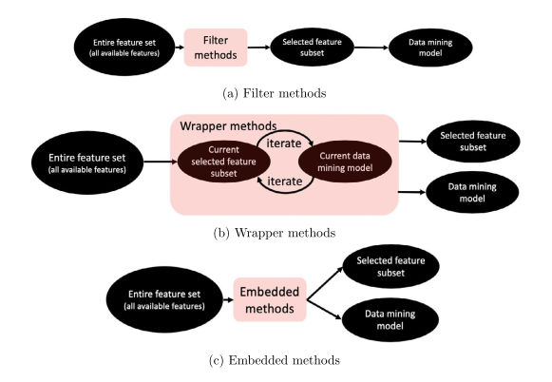
Feature selection methods
Filter methods
Independent of classification model
Wrapper methods
Combines feature selection and classifier model
Embedded methods
Embeds the feature selection model during the classification step

Slide 8
Filter Method
Selects features based on certain goodness measure of the input features
Have a goodness score for each feature and select features with highest goodness score.
Method 1: A feature is good if it highly correlated with the class label we want to predict.
Higher chi-square value indicates stronger corelation.
Select k features with highest chi-square values.
For continuous attribute
Option 1: discretize and compute chi-square
Option 2: Compute Fisher score (computes correlation between continuous value and a categorical attribute
Method 2: Information theoretic measures
Information gain
Limitations
Independent of classification model
Does not consider the interaction between the attributes.

Slide 9
Wrapper method
It is an iterative process
In each iteration
Build a classifier based on currently selected feature set and build a classifier
Update the feature set (add, remove, swap)
Straightforward method
Try all subsets of p features = 2^p-1 → exponential!
Stepwise forward selection method
Start with empty set.
Iteratively, include additional feature if it improves accuracy.
Stepwise backward selection
Start with initial P features
Iteratively eliminate a feature, if it improves accuracy
We can combine both
Other techniques
Genetic algorithms
Simulated annealing: probabilistic algorithm designed for nonconvex optimization problem

Slide 10
Embedded methods
Combines advantages of filter methods and wrapper methods
Embedded method performs feature selection and classification model construction simultaneously.
Example: decision tree
After termination, all features at non-leaf nodes are selected features.
Sparse Learning
We build data mining models by minimizing some objective function.
Example:
Least square linear regression: we want to find a weight vector w by minimizing the sum of the squared difference between the predicted output and the actual output.
Logistic regression: find the optimal vector w by minimizing the negative log likelihood.
By making the corresponding weight of the variable zero, we can remove the feature and calculate the loss function.

Slide 11
Outline
Feature Selection and Engineering
Bayesian Belief Networks
Support Vector Machines
Rule based and pattern based classification
Classification by weak supervision
Classification with rich data type
Other Classification Methods
Additional Topics Regarding Classification
Summary
11
Notes:
11

Slide 12
Bayesian belief networks
Assumption of Bayesian classifier is class conditional independence
Given the class label of a tuple, the values of the attributes are assumed to be conditionally independent of one another. This simplifies computation.
When the assumption holds true, then the naïve Bayesian classifier is the most accurate in comparison with all other classifiers.
In practice, however, dependencies can exist between variables.
Bayesian belief networks specify joint conditional probability distributions.
allow class conditional independencies to be defined between subsets of variables.
Provide a graphical model of causal relationships, on which learning can be performed.
Trained Bayesian belief networks can be used for classification.
Other names are belief networks, Bayesian networks, and probabilistic networks.
We will refer to them as belief networks

Slide 13
Bayesian Belief Networks
A belief network is defined by two components—
a directed acyclic graph and a set of conditional probability tables.
Each node in the directed acyclic graph represents a random variable.
The variables may be discrete- or continuous-valued.
They may correspond to actual attributes given in the data or to “hidden variables” believed to form a relationship
About hidden variables
In the case of medical data, a hidden variable may indicate a syndrome, representing a number of symptoms that, together, characterize a specific disease.
Each arc represents a probabilistic dependence. If an arc is drawn from a node Y to a node Z, then Y is a parent or immediate predecessor of Z, and Z is a descendant
Nodes: random variables
Links: dependency
X and Y are the parents of Z, and Y is the parent of P
No dependency between Z and P
Has no loops/cycles
X
Y
Z
P
13
Notes:
13

Slide 14
Bayesian Belief Network: An Example
CPT: Conditional Probability Table for variable LungCancer:
Family
History (FH)
Smoker (S)
(FH, S)
(FH, ~S)
(~FH, S)
(~FH, ~S)
LC
0.8
0.5
0.7
0.1
LungCancer
(LC)
Emphysema
~LC
0.2
0.5
0.3
0.9
shows the conditional probability for each possible combination of its parents
PositiveXRay
Dyspnea
Derivation of the probability of a particular combination of values of X, from CPT:
Bayesian Belief Network

Slide 15
About Example
The arcs allow the representation of casual knowledge
For example, having lung cancer is influenced by a person’s family history of lung cancer, as well as whether or not the person is a smoker.
Note that the variable PositiveXRay is independent of whether the patient has a family history of lung cancer or is a smoker, given that we know the patient has lung cancer.
In other words, once we know the outcome of the variable LungCancer, then the variables FamilyHistory and Smoker do not provide any additional information regarding PositiveXRay.
The arcs also show that the variable LungCancer is conditionally independent of Emphysema, given its parents, FamilyHistory and Smoker

Slide 16
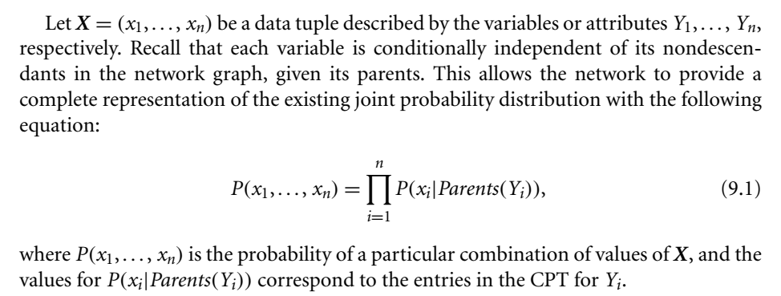
About Conditional Probability Table (CPT)
The CPT for a variable Y specifies the conditional distribution P(Y/Parents(Y)), where Parents(Y) are the parents of Y.
in CPT, the conditional probability for each known value of LungCancer is given for each possible combination of the values of its parents.
Example
P(LungCancer =yes| FamilyHistory =yes, Smoker =yes)= 0.8 P(LungCancer =no| FamilyHistory =no, Smoker =no)= 0.9.

Slide 17
Applications
Genetic linkage analysis (e.g., the mapping of genes onto a chromosomes.
Computer vision (e.g., image restoration and stereo vision)
document and text analysis
decision support systems
sensitivity analysis.

Slide 18
Training Bayesian Networks: Several Scenarios
Scenario 1: Given both the network structure and all variables observable: compute only the CPT entries
Similar to naïve Bayesian classification
Scenario 2: Network structure known, some variables hidden: gradient descent (greedy hill-climbing) method, i.e., search for a solution along the steepest descent of a criterion function
Weights are initialized to random probability values
At each iteration, it moves towards what appears to be the best solution at the moment, w.o. backtracking
Weights are updated at each iteration & converge to local optimum
Scenario 3: Network structure unknown, all variables observable: search through the model space to reconstruct network topology
Scenario 4: Unknown structure, all hidden variables: No good algorithms known for this purpose
D. Heckerman. A Tutorial on Learning with Bayesian Networks. In Learning in Graphical Models, M. Jordan, ed.. MIT Press, 1999.

Slide 19
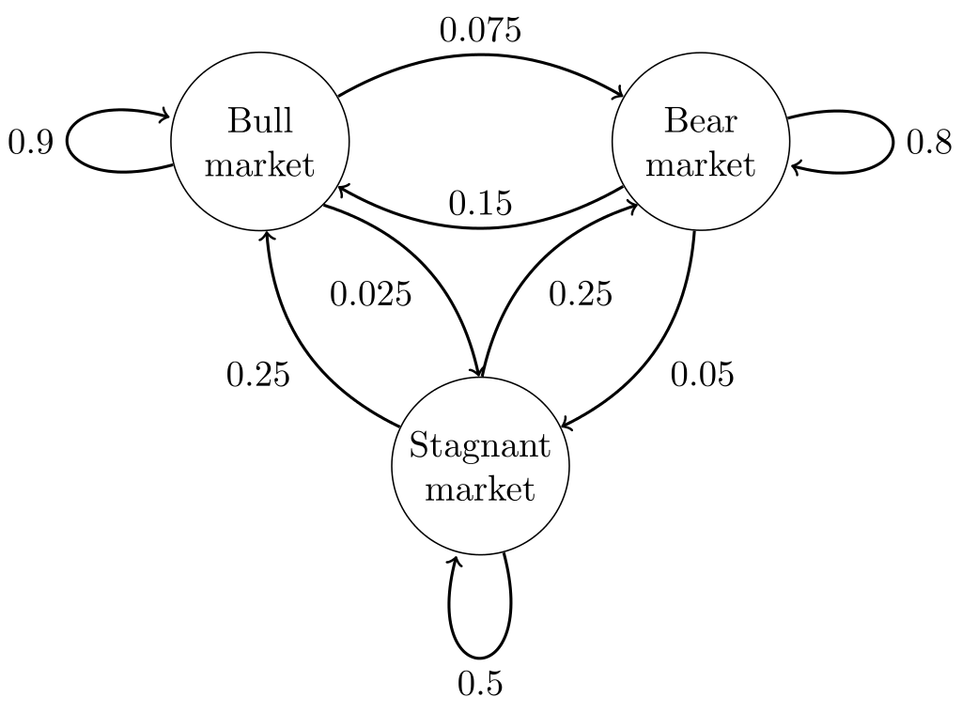
Markov Chains
Undirected graph
A Markov chain is a stochastic model that uses mathematics to predict the probability of a sequence of events occurring based on the most recent event.
Memory less
Example 1: A common example of a Markov chain in action is the way Google predicts the next word in your sentence based on your previous entry within Gmail
Example 2:The states represent whether a hypothetical stock market is exhibiting a bull market, bear market, or stagnant market trend during a given week. According to the figure, a bull week is followed by another bull week 90% of the time, a bear week 7.5% of the time, and a stagnant week the other 2.5% of the time.

Slide 20
Outline
Feature Selection and Engineering
Bayesian Belief Networks
Support Vector Machines
Rule based and pattern based classification
Classification by weak supervision
Classification with rich data type
Other Classification Methods
Additional Topics Regarding Classification
Summary
20
Notes:
20

Slide 21
SVM—Support Vector Machines
A relatively new classification method for both linear and nonlinear data
It uses a nonlinear mapping to transform the original training data into a higher dimension
With the new dimension, it searches for the linear optimal separating hyperplane (i.e., “decision boundary”)
With an appropriate nonlinear mapping to a sufficiently high dimension, data from two classes can always be separated by a hyperplane
SVM finds this hyperplane using support vectors (“essential” training tuples) and margins (defined by the support vectors)

Slide 22
SVM—History and Applications
Vapnik and colleagues (1992)—groundwork from Vapnik & Chervonenkis’ statistical learning theory in 1960s
Features: training can be slow but accuracy is high owing to their ability to model complex nonlinear decision boundaries (margin maximization)
Used for: classification and numeric prediction
Applications:
handwritten digit recognition, object recognition, speaker identification, benchmarking time-series prediction tests

Slide 23
SVM—General Philosophy
Small Margin
Large Margin
Support Vectors

Slide 24
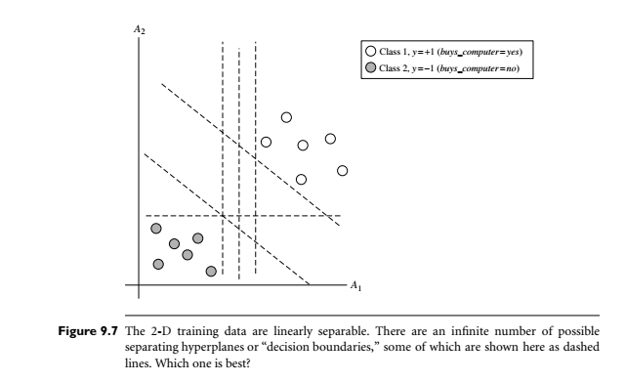

Slide 25
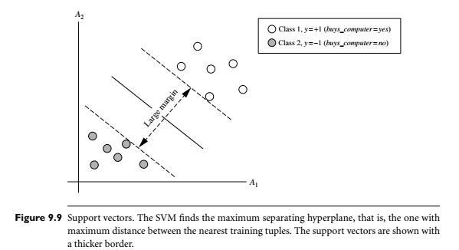

Slide 26
SVM—When Data Is Linearly Separable
m
Let data D be (X₁, y₁), …, (X_{|D|}, y_{|D|}), where X_{i} is the set of training tuples associated with the class labels y_{i}
There are infinite lines (hyperplanes) separating the two classes but we want to find the best one (the one that minimizes classification error on unseen data)
SVM searches for the hyperplane with the largest margin, i.e., maximum marginal hyperplane (MMH)

Slide 27
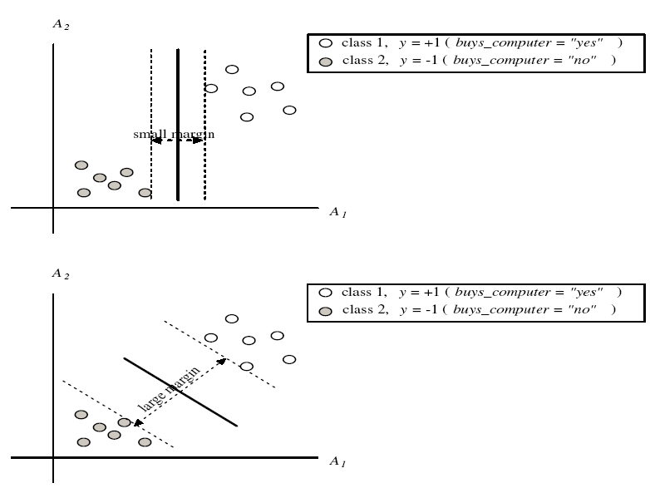
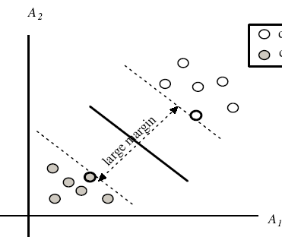
SVM—Margins and Support Vectors

Slide 28
SVM—Linearly Separable
A separating hyperplane can be written as
W ● X + b = 0
where W={w₁, w₂, …, w_{n}} is a weight vector and b a scalar (bias)
For 2-D it can be written as
w₀ + w₁ x₁ + w₂ x₂ = 0
The hyperplane defining the sides of the margin:
H₁: w₀ + w₁ x₁ + w₂ x₂ ≥ 1 for y_{i} = +1, and
H₂: w₀ + w₁ x₁ + w₂ x₂ ≤ – 1 for y_{i} = –1
Any training tuples that fall on hyperplanes H₁ or H₂ (i.e., the sides defining the margin) are support vectors
This becomes a constrained (convex) quadratic optimization problem: Quadratic objective function and linear constraints → Quadratic Programming (QP) → Lagrangian multipliers method

Slide 29
Why Is SVM Effective on High Dimensional Data?
The complexity of trained classifier is characterized by the # of support vectors rather than the dimensionality of the data
The support vectors are the essential or critical training examples —they lie closest to the decision boundary, maximum marginal hyperplane (MMH)
If all other training examples are removed and the training is repeated, the same separating hyperplane would be found
The number of support vectors found can be used to compute an (upper) bound on the expected error rate of the SVM classifier, which is independent of the data dimensionality
Thus, an SVM with a small number of support vectors can have good generalization, even when the dimensionality of the data is high

Slide 30
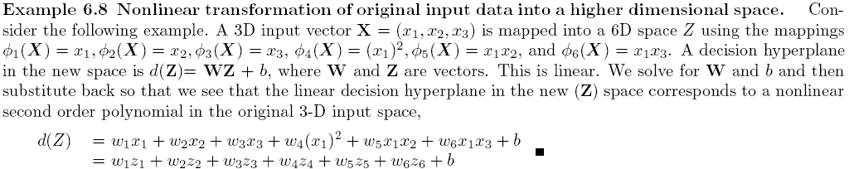
SVM—Linearly Inseparable
Transform the original input data into a higher dimensional space
Search for a linear separating hyperplane in the new space
Computation is costly.

Slide 31
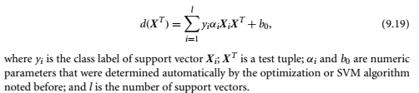
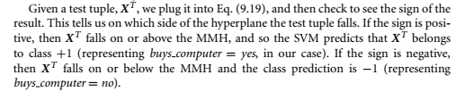
Using SVM for classification
“Once I’ve got a trained support vector machine, how do I use it to classify test (i.e., new) tuples?” Based on the Lagrangian formulation mentioned before, the MMH (maximum marginal hyperplane ) can be rewritten as the decision boundary.

Slide 32
SVM vs. Neural Network
SVM
Deterministic algorithm
Nice generalization properties
Hard to learn – learned in batch mode using quadratic programming techniques
Using kernels can learn very complex functions
Neural Network
Nondeterministic algorithm
Generalizes well but doesn’t have strong mathematical foundation
Can easily be learned in incremental fashion
To learn complex functions—use multilayer perceptron (nontrivial)

Slide 33
SVM Related Links
SVM Website: http://www.kernel-machines.org/
Representative implementations
LIBSVM: an efficient implementation of SVM, multi-class classifications, nu-SVM, one-class SVM, including also various interfaces with java, python, etc.
SVM-light: simpler but performance is not better than LIBSVM, support only binary classification and only in C
SVM-torch: another recent implementation also written in C

Slide 34
Outline
Feature Selection and Engineering
Bayesian Belief Networks
Support Vector Machines
Rule based and pattern based classification
Classification by weak supervision
Classification with rich data type
Other Classification Methods
Additional Topics Regarding Classification
Summary
34
Notes:
34

Slide 35
Rule-based classification
A classifier is a set of rules
A rule based classifier uses a set of IF THEN rules for classification.
An IF-THEN rule is an expression of the form
IF condition THEN conclusion
Example
R1: IF age=youth AND student=yes THEN buys_computer= yes
The IF part of the rule is antecedent or precondition
The THEN part of the rule is the rule consequent.

Slide 36
Using IF-THEN Rules for Classification
Assessment of a rule: coverage and accuracy
n_{covers} = # of tuples covered by R
n_{correct} = # of tuples correctly classified by R
coverage(R) = n_{covers} /|D| /* D: training data set */
accuracy(R) = n_{correct} / n_{covers}
If more than one rule are triggered, need conflict resolution
Size ordering: assign the highest priority to the triggering rules that has the “toughest” requirement (i.e., with the most attribute tests)
Class-based ordering: decreasing order of prevalence or misclassification cost per class
Rule-based ordering (decision list): rules are organized into one long priority list, according to some measure of rule quality or by experts

Slide 37
Rule Extraction from a Decision Tree
Rules are easier to understand than large trees
One rule is created for each path from the root to a leaf
Each attribute-value pair along a path forms a conjunction: the leaf holds the class prediction
Rules are mutually exclusive and exhaustive
age?
<=30
31..40
>40
student?
yes
credit rating?
no
yes
excellent
fair
no
yes
no
yes
Example: Rule extraction from our buys_computer decision-tree
IF age = young AND student = no THEN buys_computer = no
IF age = young AND student = yes THEN buys_computer = yes
IF age = mid-age THEN buys_computer = yes
IF age = old AND credit_rating = excellent THEN buys_computer = no
IF age = old AND credit_rating = fair THEN buys_computer = yes

Slide 38
Rule Induction: Sequential Covering Method
Sequential covering algorithm: Extracts rules directly from training data
Typical sequential covering algorithms: FOIL, AQ, CN2, RIPPER
Rules are learned sequentially, each for a given class C_{i} will cover many tuples of C_{i} but none (or few) of the tuples of other classes
Steps:
Rules are learned one at a time
Each time a rule is learned, the tuples covered by the rules are removed
Repeat the process on the remaining tuples until termination condition, e.g., when no more training examples or when the quality of a rule returned is below a user-specified threshold
Comp. w. decision-tree induction: learning a set of rules simultaneously

Slide 39
Sequential Covering Algorithm
while (enough target tuples left)
generate a rule
remove positive target tuples satisfying this rule
Examples covered
by Rule 2
Examples covered
by Rule 1
Examples covered
by Rule 3
Positive examples

Slide 40
Rule Generation
To generate a rule
while(true)
find the best predicate p
if foil-gain(p) > threshold then add p to current rule
else break
A3=1
A3=1&&A1=2
A3=1&&A1=2
&&A8=5
Positive examples
Negative examples

Slide 41
How to Learn-One-Rule?
Start with the most general rule possible: condition = empty
Adding new attributes by adopting a greedy depth-first strategy
Picks the one that most improves the rule quality
FOIL- First Order Inductive Learner
Rule-Quality measures: consider both coverage and accuracy
Let pos and neg be the number of positive and negative tuples learned by R and pos’ and neg’ be the number of positive and negative tuples learned by R’
Foil-gain (in FOIL & RIPPER): assesses info_gain by extending condition
favors rules that have high accuracy and cover many positive tuples
Rule pruning based on an independent set of test tuples. Given R
Pos/neg are # of positive/negative tuples covered by R.
If FOIL_Prune is higher for the pruned version of R, prune R

Slide 42
Associative Classification
Associative classification: Major steps
Mine data to find strong associations between frequent patterns (conjunctions of attribute-value pairs) and class labels
Association rules are generated in the form of
P₁ ^ p₂ … ^ p_{l} → “A_{class} = C” (conf, sup)
Organize the rules to form a rule-based classifier
Why effective?
It explores highly confident associations among multiple attributes and may overcome some constraints introduced by decision-tree induction, which considers only one attribute at a time
Associative classification has been found to be often more accurate than some traditional classification methods, such as C4.5
42
Notes:
42

Slide 43
Typical Associative Classification Methods
CBA (Classification Based on Associations: Liu, Hsu & Ma, KDD’98)
Mine possible association rules in the form of
Cond-set (a set of attribute-value pairs) → class label
Build classifier: Organize rules according to decreasing precedence based on confidence and then support
CMAR (Classification based on Multiple Association Rules: Li, Han, Pei, ICDM’01)
Classification: Statistical analysis on multiple rules
CPAR (Classification based on Predictive Association Rules: Yin & Han, SDM’03)
Generation of predictive rules (FOIL-like analysis) but allow covered rules to retain with reduced weight
Prediction using best k rules
High efficiency, accuracy similar to CMAR
43

Slide 44
Discriminative Frequent Pattern Classification
This topic is not included.

Slide 45
Outline
Feature Selection and Engineering
Bayesian Belief Networks
Support Vector Machines
Rule based and pattern based classification
Classification by weak supervision
Classification with rich data type
Other Classification Methods
Additional Topics Regarding Classification
Summary
45
Notes:
45

Slide 46
Weak Supervision
SVM, Logistic regression, k-NN
Strong supervision: require large number of high quality training tuples annotated by domain experts.
In real work, training set is not available.
Document classification, speech recognition, computer vision
One minute of speech requires 10 minutes to label
For annotating sounds, it takes 400 times more
Classification approaches are required for limited number of training samples or no training samples.

Slide 47
Semi-Supervised Classification
Semi-supervised: Uses labeled and unlabeled data to build a classifier
Self-training:
Build a classifier using the labeled data
Use it to label the unlabeled data, and those with the most confident label prediction are added to the set of labeled data
Repeat the above process
Adv: easy to understand; disadv: may reinforce errors
Co-training: Use two or more classifiers to teach each other
Each learner uses a mutually independent set of features of each tuple to train a good classifier, say f1 and f2
Then f1 and f2 are used to predict the class label for unlabeled data X
Teach each other: The tuple having the most confident prediction from f₁ is added to the set of labeled data for f₂, & vice versa
Other methods, e.g., joint probability distribution of features and labels
47

Slide 48
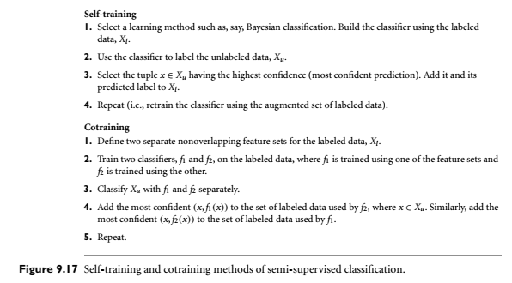

Slide 49
Active Learning
Class labels are expensive to obtain
Active learner: query human (oracle) for labels
Pool-based approach: Uses a pool of unlabeled data
L: a small subset of D is labeled, U: a pool of unlabeled data in D
Use a query function to carefully select one or more tuples from U and request labels from an oracle (a human annotator)
The newly labeled samples are added to L, and learn a model
Goal: Achieve high accuracy using as few labeled data as possible
Evaluated using learning curves: Accuracy as a function of the number of instances queried (# of tuples to be queried should be small)
Research issue: How to choose the data tuples to be queried?
Uncertainty sampling: choose the least certain ones
Reduce version space, the subset of hypotheses consistent w. the training data
Reduce expected entropy over U: Find the greatest reduction in the total number of incorrect predictions
49

Slide 50
Transfer Learning: Conceptual Framework
Transfer learning: Extract knowledge from one or more source tasks and apply the knowledge to a target task
Classification of camera reviews to classification of TV reviews
Traditional learning: Build a new classifier for each new task
Transfer learning: Build new classifier by applying existing knowledge learned from source tasks
Traditional Learning Framework
Transfer Learning Framework
50

Slide 51
Transfer Learning: Methods and Applications
Applications: Especially useful when data is outdated or distribution changes, e.g., Web document classification, e-mail spam filtering
Instance-based transfer learning: Reweight some of the data from source tasks and use it to learn the target task
TrAdaBoost (Transfer AdaBoost)
Assume source and target data each described by the same set of attributes (features) & class labels, but rather diff. distributions
Require only labeling a small amount of target data
Use source data in training: When a source tuple is misclassified, reduce the weight of such tupels so that they will have less effect on the subsequent classifier
Research issues
Negative transfer: When it performs worse than no transfer at all
Heterogeneous transfer learning: Transfer knowledge from different feature space or multiple source domains
Large-scale transfer learning
51

Slide 52
Genetic Algorithms (GA)
Genetic Algorithm: based on an analogy to biological evolution
An initial population is created consisting of randomly generated rules
Each rule is represented by a string of bits
E.g., if A₁ and ¬A₂ then C₂ can be encoded as 100
If an attribute has k > 2 values, k bits can be used
Based on the notion of survival of the fittest, a new population is formed to consist of the fittest rules and their offspring
The fitness of a rule is represented by its classification accuracy on a set of training examples
Offspring are generated by crossover and mutation
The process continues until a population P evolves when each rule in P satisfies a prespecified threshold
Slow but easily parallelizable

Slide 53
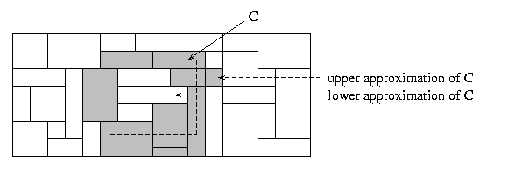
Rough Set Approach
Rough sets are used to approximately or “roughly” define equivalent classes
A rough set for a given class C is approximated by two sets: a lower approximation (certain to be in C) and an upper approximation (cannot be described as not belonging to C)
Finding the minimal subsets (reducts) of attributes for feature reduction is NP-hard but a discernibility matrix (which stores the differences between attribute values for each pair of data tuples) is used to reduce the computation intensity

Slide 54
Fuzzy sets
The word “fuzzy” means “vaguness (ambiguity)”.
Fuzziness occurs when the boundary of a piece of information is not clear-cut.
Fuzzy sets - 1965 Lotfi Zadeh as an extension of classical notation set.
Classical set theory allows the membership of the elements in the set in binary terms.
Fuzzy set theory permits membership function valued in the interval [0,1].

Slide 55
Fuzzy sets
Example:
Words like young, tall, good or high are fuzzy.
There is no single quantitative value which defines the term young.
For some people, age 25 is young, and for others, age 35 is young.
The concept young has no clean boundary.
Age 35 has some possibility of being young and usually depends on the context in which it is being considered.
•
•
•
Fuzzy set theory is an extension of classical set theory where elements have degree of membership.

Slide 56
Introduction
•
In real world, there exist much fuzzy knowledge (i.e. vague, uncertain inexact etc).
•
Human thinking and reasoning (analysis, logic, interpretation) frequently involved fuzzy information.
Human can give satisfactory answers, which are probably true.
Our systems are unable to answer many question because the systems are designed based upon classical set theory (Unreliable and incomplete).
•
•
•
We want, our system should be able to cope with unreliable and incomplete information.
Fuzzy system have been provide solution.
•

Slide 57
Introduction
Classical set theory
Classes of objects with sharp boundaries.
A classical set is defined by crisp(exact) boundaries, i.e., there is no uncertainty about the location of the set boundaries.
Widely used in digital system design
Fuzzy set theory
Classes of objects with un- sharp boundaries.
A fuzzy set is defined by its ambiguous boundaries, i.e., there exists uncertainty about the location of the set boundaries.
Used in fuzzy controllers.

Slide 58
Introduction (Continue)
Example
Yes! (1)
Crisp
Is water colorless?
No! (0)
Extremely Honest (1)
Very Honest (0.80)
Fuzzy
Honest at time (0.40)
Is Ram Honest?
Extremely dishonest (0.0)
Fuzzy vs crips

Slide 59
Classical set theory
•
•
A Set is any well defined collection of objects.
An object in a set is called an element or member of that set.
Sets are defined by a simple statement,
Describing whether a particular element having a certain propertybelongs to that particular set.
A = {a₁,a₂,a₃,……,a_{n}}
If the elements a_{i} (i = 1,2,3,….,n) of a set A are subset of universal set X, then set A can be represented for all elements x ϵ X by its characteristics function
µ_{A} (x) = 1 if x ϵ X otherwise 0
•
•

Slide 60
Operations on classical set theory
Union: the union of two sets A and B is given as
A U B = { x | x є A or x є B }
Intersection: the intersection of two sets A and B is given as A ∩ B = { x | x є A and x є B }
Complement: It is denoted by Ã and is defined as
Ã = { x | x does not belongs A and x є X }

Slide 61
Fuzzy Sets
Fuzzy sets theory is an extension of classical set theory.
Elements have varying degree of membership. A logic based on two truth values,
True and False is sometimes insufficient when describing human reasoning.
Fuzzy Logic uses the whole interval between 0 (false) and 1 (true) to describe human reasoning.
A Fuzzy Set is any set that allows its members to have different degree of membership, called membership function, having interval [0,1].

Slide 62
Fuzzy Sets
Fuzzy Logic is derived from fuzzy set theory
Many degree of membership (between 0 to 1) are allowed.
Thus a membership function µ_{A}^{(x)} is associated with a fuzzy
sets Ã such that the function maps every universe of discourse X to the interval [0,1].
The mapping is written as: µ_{Ã}(x): X → [0,1].
element of
Fuzzy Logic is capable of handing inherently (vague or inexact or rough or inaccurate) concepts
imprecise

Slide 63
Fuzzy Sets
Fuzzy set is defined as follows:
If X is an universe of discourse and x is a particular element of X, then a fuzzy set A defined on X and can be written as a collection of ordered pairs
A = {(x, µ_{Ã}(x)), x є X }

Slide 64
Fuzzy Sets (Continue)
Example
Let X = {g₁, g₂, g₃, g₄, g₅} be the reference set of students.
Let Ã be the fuzzy set of “smart” students, where “smart” is fuzzy term.
Ã = {(g₁,0.4)(g₂,0.5)(g₃,1)(g₄,0.9)(g₅,0.8)}
Here Ã indicates that the smartness of g₁ is 0.4 and so on

Slide 65
Fuzzy Sets (Continue)
Membership Function
The membership function fully defines the fuzzy set
A membership function provides a measure of the degree of similarity of an element to a fuzzy set
Membership functions can
either be chosen by the user arbitrarily, based on the user’s experience (MF chosen by two users could be different depending upon their experiences, perspectives, etc.)
Or be designed using machine learning methods (e.g., artificial neural networks, genetic algorithms, etc.)

Slide 66
Fuzzy Sets (Continue)
There are different shapes of membership functions;
•
•
•
Triangular, Trapezoidal, Gaussian, etc

Slide 67
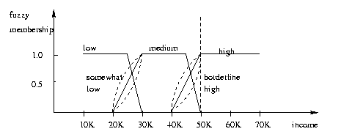
Fuzzy Set Classification
Fuzzy logic uses truth values between 0.0 and 1.0 to represent the degree of membership (such as in a fuzzy membership graph)
Attribute values are converted to fuzzy values. Ex.:
Income, x, is assigned a fuzzy membership value to each of the discrete categories {low, medium, high}, e.g. $49K belongs to “medium income” with fuzzy value 0.15 but belongs to “high income” with fuzzy value 0.96
Fuzzy membership values do not have to sum to 1.
Each applicable rule contributes a vote for membership in the categories
Typically, the truth values for each predicted category are summed, and these sums are combined

Slide 68
Outline
Bayesian Belief Networks
Classification by Backpropagation
Support Vector Machines
Classification by Using Frequent Patterns
Lazy Learners (or Learning from Your Neighbors)
Other Classification Methods
Additional Topics Regarding Classification
Summary
68
Notes:
68

Slide 69
Additional Topics
SVM is the binary classifier. How to build a classifier if there are more than one classes?
Solution: Multiclass classification
Classification requires labelled data
But, labelled data is not available
It is very expensive to label
Example
Speech recognition: 1 minute speech takes 10 minutes to label
Annotating phonemes (basic units of sound) can take 400 times as long
Solution: Semi-supervised classification

Slide 70
Multiclass Classification
Classification involving more than two classes (i.e., > 2 Classes)
Method 1. One-vs.-all (OVA): Learn a classifier one at a time
Given m classes, train m classifiers: one for each class
Classifier j: treat tuples in class j as positive & all others as negative
To classify a tuple X, the set of classifiers vote as an ensemble
Method 2. All-vs.-all (AVA): Learn a classifier for each pair of classes
Given m classes, construct m(m-1)/2 binary classifiers
A classifier is trained using tuples of the two classes
To classify a tuple X, each classifier votes. X is assigned to the class with maximal vote
Comparison
All-vs.-all tends to be superior to one-vs.-all
Problem: Binary classifier is sensitive to errors, and errors affect vote count
70

Slide 71
Error-Correcting Codes for Multiclass Classification
Originally designed to correct errors during data transmission for communication tasks by exploring data redundancy
Example
A 7-bit codeword associated with classes 1-4
Class | Error-Corr. Codeword
C₁ | 1 | 1 | 1 | 1 | 1 | 1 | 1
C₂ | 0 | 0 | 0 | 0 | 1 | 1 | 1
C₃ | 0 | 0 | 1 | 1 | 0 | 0 | 1
C₄ | 0 | 1 | 0 | 1 | 0 | 1 | 0
Given a unknown tuple X, the 7-trained classifiers output: 0001010
Hamming distance: # of different bits between two codewords
H(X, C₁) = 5, by checking # of bits between [1111111] & [0001010]
H(X, C₂) = 3, H(X, C₃) = 3, H(X, C₄) = 1, thus C₄ as the label for X
Error-correcting codes can correct up to (h-1)/h 1-bit error, where h is the minimum Hamming distance between any two codewords
If we use 1-bit per class, it is equiv. to one-vs.-all approach, the code are insufficient to self-correct
When selecting error-correcting codes, there should be good row-wise and col.-wise separation between the codewords
71

Slide 72
Summary
Effective and advanced classification methods
Bayesian belief network (probabilistic networks)
Backpropagation (Neural networks)
Support Vector Machine (SVM)
Pattern-based classification
Other classification methods: lazy learners (KNN, case-based reasoning), genetic algorithms, rough set and fuzzy set approaches
Additional Topics on Classification
Multiclass classification
Semi-supervised classification
Active learning
Transfer learning

